Slide 1
Containers 101
Mofe salami

Slide 2
About me
Studied Computer and Business Studies at Uni. of Warwick
Worked at IBM as a developer for 2 ½ years
Worked in an agile team that developed Java based micro-services shipped as helm charts to be managed in K8s
Manchester United Fan
Love Fifa & Fortnite

Slide 3
agenda
Containers:
Setting the scene
What are containers?
What are the advantages of containers?
Docker:
What is Docker?
Overview of the Docker ecosystem
Hands-on Workshop

Slide 4
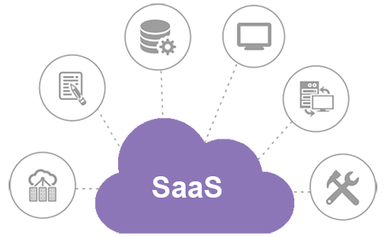
changes to software consumption
BEFORE: “Download our software and follow the docs to configure your environment”
NOW: “Here is the software, we’ll host it, just access it over the internet”
WHY?
It just works
We don’t have expertise
We don’t care
Notes:
Before we look at why containers are here we have to look at the change in attitudes of consumers using software.
Traditionally, a customer would have to spend significant effort downloading, installing and configuring vendor software.
You could spend a week to have fully functional software on-prem especially if you have to worry about fun things such as verifying security
Most customers especially smaller business are not looking for on-prem solutions but dependent on their requirements will be buying SaaS (Software-as-a-service)
The main advantage of buying XaaS is that you pay someone else to do the bits they do well so you can focus more time and resources on what you actually care about

Slide 5
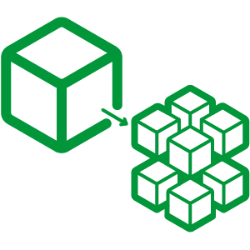
Changes to building software
BEFORE: “Let’s build this thing that can do A, B and C… and Z and then we’ll test it in a year!”
NOW: “Let’s have short dev. cycles and split into smaller teams working on capabilities”
WHY?
More efficient to reuse smaller components
More efficient to scale with smaller components
Easier to do agile with smaller components
Notes:
As more people have begun to consume their software as a service, the way in which developments teams develop software has also had to evolve.
We’ve gone from banging in all the features we can think of over long periods of time to developing smaller sets of services in agile cycles
We now write micro-services!
Additional services can be created by a combination of re-using existing components and adding the new functionality saving time and monetary efforts
Scaling can be done to the critical components rather than the entire product
Developing micro-services makes it easier to do agile → you can develop, test and upgrade components that are even running in live environments easier and faster.
Customers know that all software has bugs. A customer is more concerned about how quick bugs get fixed and expects fixes to happen seamlessly

Slide 6

Experience is the best teacher…
VI – Processes - Execute the app as one or more stateless processes
VII – Concurrency - Scale out via the process model
IX – Disposability – Maximize robustness with fast startup and graceful shutdown
https://12factor.net
Notes:
During the time
Basically talk about how the development team for Heroku have experience with running and scaling thousands of services and have come up with a set of principles that should be followed when developing SaaS applications

Slide 7
Where do containers fit into this?

Slide 8
Container basics
A container contains!
Virtualizing the hardware OS subsystems
Interaction with a single OS
Notes:
A container contains = container securely isolates resources and processes from both the host and other containers

Slide 9
Container isolation
Namespaces
“What you can see”
Process IDs
Filesystems
Users
IPC
Networking
Cgroups
“what you can use”
CPU
Memory
Disk I/O
Network
Device permissions (/dev)

Slide 10
VMs vs. container virtualization
App 1
App 2
App 3
Bins/Libs
Bins/Libs
Bins/Libs
Guest OS
Guest OS
Guest OS
App 1
App 2
App 3
Bins/Libs
Bins/Libs
Bins/Libs
Hypervisor
Container Engine
Host Operating System
Host Operating System
Physical Server
Physical Server
Notes:
The concept of isolation are not new or exclusive to containers and apply to VMs
Looking at a service provider like OpenStack, they would have many physical servers running hypervisors.
The hypervisors would allow you to run multiple isolated Virtual Machines by virtualizing the underlying hardware
Looking at containers however, we replace the hypervisor with a container engine which you don’t have to worry about too much now but this allows us to strip out the Guest OS for each of isolated environment
The obvious between these two is that with VMs there is interaction with the Host and Guest OS whereas with containers, its only the Host OS
Immediately, we can see that containers have a instant advantage over VMs as the contained environment is leaner
Another difference is that with VMs, the user must install their dependencies on the Guest before they use their application whereas with containers, the dependencies are packaged within the container.

Slide 11
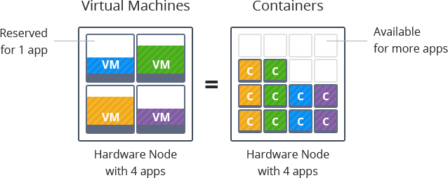
Advantages
Notes:
SMALLER SIZE FASTER APP - As the order in size of containers are usually in the order of MBs the startup times are almost negligible
BUILT-IN DEPS Because the dependencies of containers are built-in, a user doesn’t have to worry about what OS and which version they are running but only needs the container engine installed on the host. Developers can write an test code using containers and publish it to any other environment and works the same. In fact, we’re reaching the point where we are able to run Windows and Linux containers side-by-side with windows having native Linux Container support (check out the moby project)
ISOLATION & EFFICIENCY As mentioned before, you can run multiple containers on a single host and still have these isolated environments as you do with VMs. This has major implications with service providers as they can throw away the GBs of Guest OS systems image they required for VMs and instead load their Host OS with many more containers

Slide 12
So containers are a new thing?

Slide 13
Well, not so new…
Unix V7’s Chroot – 1979
Linux VServer – 2001
Oracle Solaris Containers – 2004
Open VZ (Open Virtuzzo) - 2005
Google’s Process Containers (Control Groups – cgroups) – 2006
LXC (Linux Containers) – 2008
CloudFoundry’s Warden – 2011
Docker – 2013
Open Container Initiative – 2015
The rise of the container tools – 2017
Notes:
Well container technology has been around for yeas, in fact the with Unix’s V7, the introduction of chroot was the beginning of process isolation
Linux VServer was one of several companies who created the concept of jails where resources on a machine would be partitioned. This was done by patching the Linux kernel
Oracle’s Solaris containers had a similar concept to jails called zones which leveraged snapshot features
Open VZ is a system container runtime that would boot a full linux distro similar to a VM. Again this worked via. patching the Linux kernel
Google’s Process Containers was designed manage resources tied to a collection of processes.
After being branded as cgroups in 2007 was later merged to Linux kernel
Unlike previous solutions, every solution from here forward no longer needed a patched kernel or multiple kernels – in fact LXC get credit for the first most complete container manager making use of the kernel features: cgroups and namespaces
CF’s Warden initially implemented LXC, but currently uses its own container back-end Garden to isolate environment on any OS
Finally, the almighty Docker was released which boasted a container management ecosystem that was intuitive
Its also worth mentioning the OCI which was established by Docker as an standardization for container images and container runtimes
And also mentioning that in the last few years, we have entered into a phase where many tools are born to manage containers on top of Kubernetes

Slide 14
What is docker?
Notes:
Probably worth mentioning that from this point on, any reference to containers will focus on Docker containers

Slide 15

Docker basics
The Docker image format
Docker engine which instantiates containers and manages the lifecycle
Notes:
When we talk about Docker, we are essentially talking about
The Docker image format, which is the equivalent to a Java class in the sense that we can create instances from this image format
We then have the Docker engine which takes care of creating and managing these containers

Slide 16
DOCKER ARCHITECTURE
OS
DOCKER ENGINE
REGISTRY
PUSH
DOCKERFILE _____________________________________________________________________________________________
BUILD
IMAGES
PULL
RUN
COMMIT
CONTAINERS

Slide 17
Dockerfile
Each line is a layer
Dockerfile commands:
FROM
LABEL
RUN
CMD/ENTRYPOINT
VOLUME
ENV
EXPOSE
FROM ubuntu
LABEL maintainer=“Bob Smith (bob.smith@gmail.com)”
RUN apt-get update
RUN apt-get install -y nginx
CMD ["nginx", "-g", "daemon off;"]
EXPOSE 80
Notes:
So in this example we have a Dockerfile for a custom built nginx running on ubuntu
FROM is the starting point for every Dockerfile. It tells you where your image starts from – this is great as you don’t have to worry about standard applications / components e.g. the ubuntu image has the minimum requiremenets for running ubuntu in its layer
LABEL allows you to set metadata for your image
RUN runs a command and commits the result to the image
CMD/ENTRYPOINT sets the default command to run when you enter the container
EXPOSE allows you to access your application outside of the container

Slide 18
Docker images
FROM ubuntu
LABEL maintainer=“Bob Smith (bob.smith@gmail.com)”
RUN apt-get update
RUN apt-get install -y nginx
CMD ["nginx", "-g", "daemon off;"]
EXPOSE 80
3d92d4c5112 EXPOSE 80 0B
C8577c27a2ef CMD [“nginx”, ”-… 0B
9ee6b6aa5847 RUN apt-get inst… 57.5MB
103ccd6ad90f RUN apt-get upd… 40.3MB
d2603e1b347d LABEL maintaine… 0B
ad89def2e29b FROM ubuntu 80MB
Notes:
Each line in the Dockerfile translates to a separate layer within the docker image
Here our application image is 177MB which starts up containers in under a second
In the diagram the ubuntu layer is a single layer but realistically, it contains about 4/5 more layers and is can be thought of as the link to the ubuntu Dockerfile
When building the image, the Dockerfile pulls the ubuntu image from the official docker registry on DockerHub
The nice thing about this image format is that if you create or use another image using ubunt, Docker will use the local cache of this layer and any other layers you had that were the same and will only pull in the diff layers – so running the default ubuntu image wouldn’t take up any storage since the image is used within nginx

Slide 19
Workshop time!
Go to: https://github.com/mofsal/containers101

Slide 20
So what now?
Liz Rice – “What is a container, really? Let's write one in Go from scratch” https://youtu.be/HPuvDm8IC-4
Ed Shee – “Why Developers Shouldn’t Care About Containers” CloudNativeLondon 2018 [26th-28th Sep] https://skillsmatter.com/conferences/10160-cloudnative-london-2018#program
I want to orchestrate the deployment of my microservices → Docker-compose
I want to learn Kubernetes on my local machine → Minikube
I am thinking of running my mirco-services in production and concerned about HA → Kubernetes
I have micro-services running in Kubernetes and would like to better manage the deployment→ Helm
None of the above actually interests me, I just want to code! → Cloud Foundry

